Slide 1
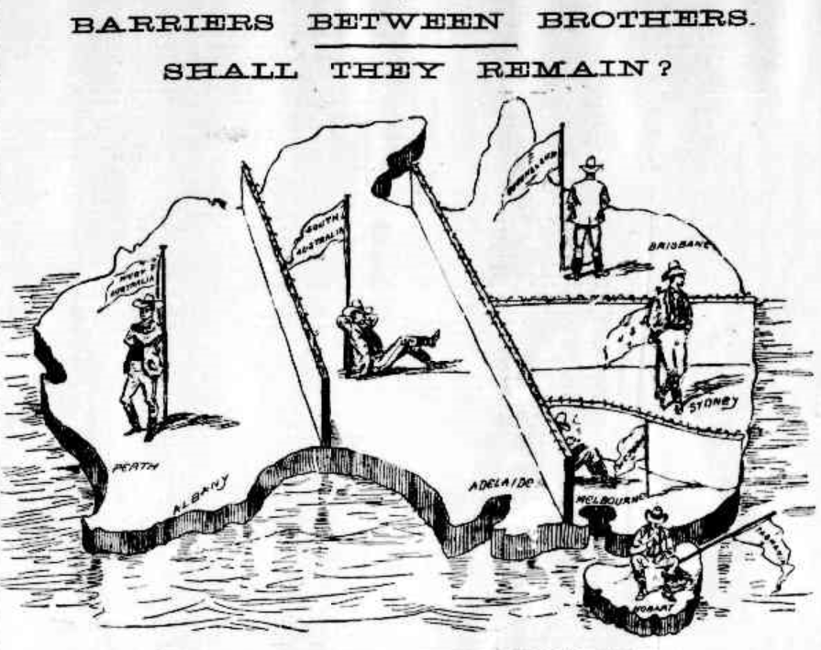
Problems of colonial life
Political cartoon from The Argus newspaper, Melbourne, 1898
Australia in the 19th century
Teacher Tip
Use slideshow mode.
Notes:
During the 1800s, many significant events occurred in the Australian colonies that brought about changes to society. The colonies were ready to grow and develop but there were still many problems or barriers standing in the way of progress. Let’s have a look at the problems of the colonial system.

Slide 2
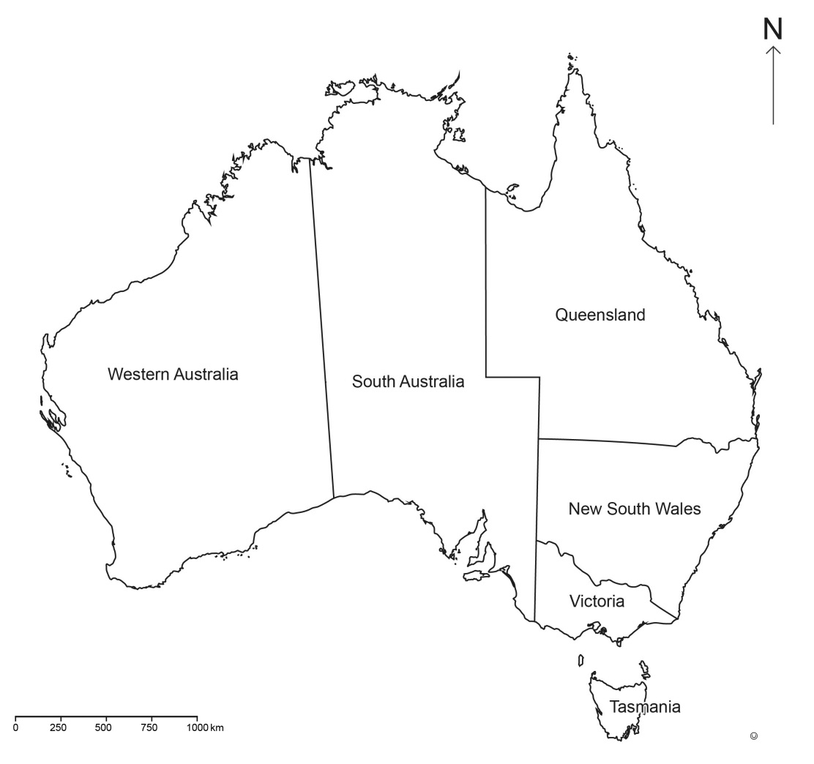
Government
In this age of high-speed internet, could you imagine waiting months for news from Britain or paying almost a week’s wages to use the telegraph system?
The six separate colonies could have their laws rejected by Britain.
Notes:
By the late 1800s, the word ‘Australia’ was used but it described the continent, not a nation. There were six distinct colonies and each considered itself to be separate and different from the others. Each colony had its own written constitution, parliament and laws, but Britain could reject any laws the colonies made and could itself make laws for the colonies. Of course, Britain was a very long way away from Australia and colonists increasingly came to see their parliaments as important and capable of making their own decisions. (Click) In this age of high-speed internet, could you imagine waiting months for news from Britain or paying almost a week’s wages to use the telegraph system to send someone a message?

Slide 3
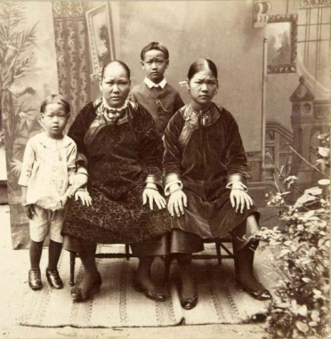
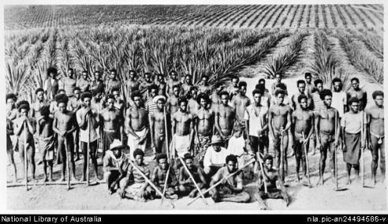
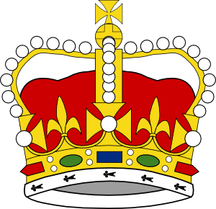
Employment of migrants
South Sea Islanders worked on the plantations in North Queensland.
Many Chinese migrants worked in the goldfields.
There was tension between established colonists and migrant workers over access to jobs and working conditions.
Notes:
Many people had a British heritage and considered Britain ‘home’ ... but the population was changing.
(Click) Many migrants had come to Australia from China during the gold rushes in the mid-1800s to work in the goldfields.
(Click) The opening up of cane farms in North Queensland also brought many South Sea Islanders to the colony as workers.
The Chinese and South Sea Islanders worked very hard and usually got paid much less than the colonists. Although the migrant workers had no other choice but to accept the lower pay, (Click) established colonists became angry when they couldn’t get work but migrant workers could. This caused a lot of tension between established colonists and migrant workers.

Slide 4
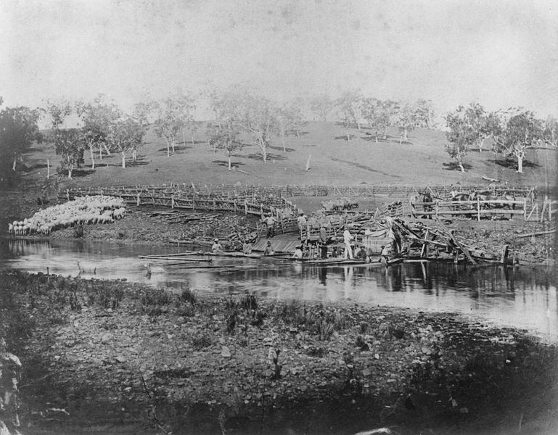
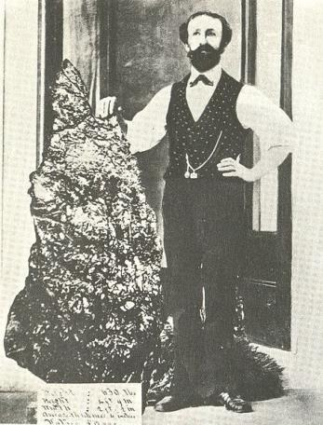
Power
Some colonies thought they deserved more power and influence due to their greater wealth.
Victoria and New South Wales were wealthier than the other colonies due to farming and the discovery of gold.
Bernard Otto Holterman with 630 pounds of gold
Notes:
Some colonies were wealthier than others. (Click) Their fertile farmlands and the (Click) discovery of gold in Victoria and New South Wales was an advantage for some colonies. This caused rivalry between the colonies, as some colonies believed they were more important and deserved more power because of their greater wealth.

Slide 5
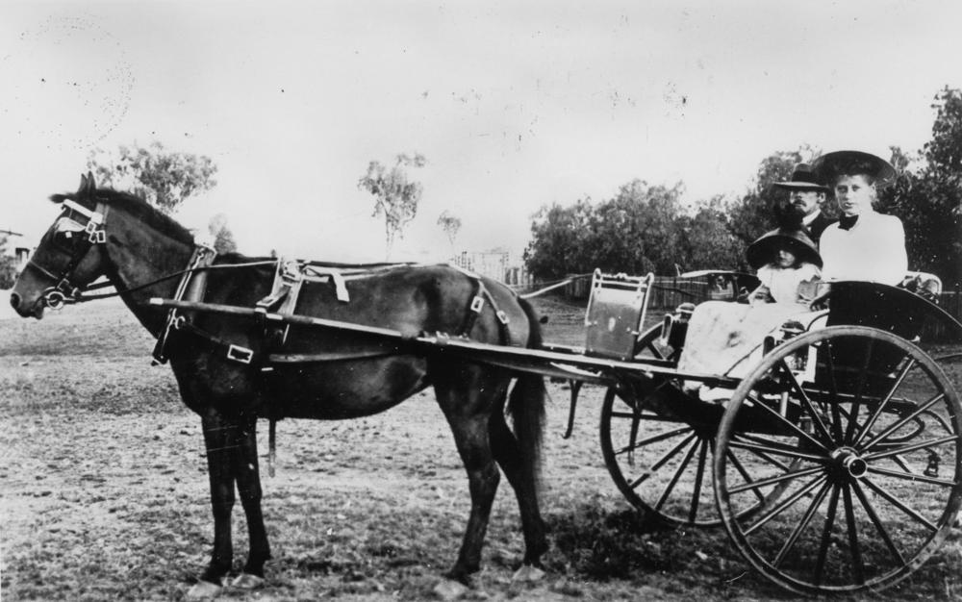
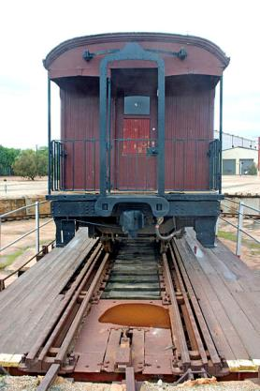



Transport
Transport was very difficult and inefficient.
Family in a horse drawn buggy in Bundaberg, c. 1912
Imagine changing trains with all your luggage at the colonial borders in the middle of the night!
There were three different rail gauges on the continent.
Notes:
The transportation of people and goods between colonies was very inefficient and difficult. (Click) People generally travelled around the colonies in buggies or on horseback, but around the 1850s, the colonies began building railways. (Click) The railways were mostly built by private companies so different track widths, (Click) called gauges, were used. In fact, three different gauges were used across the continent.
This meant that (Click) people and goods travelling from one colony to another had to change trains at the border to complete their journey, sometimes in the middle of the night!

Slide 6
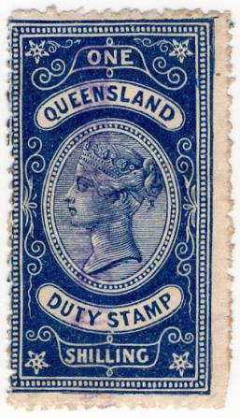
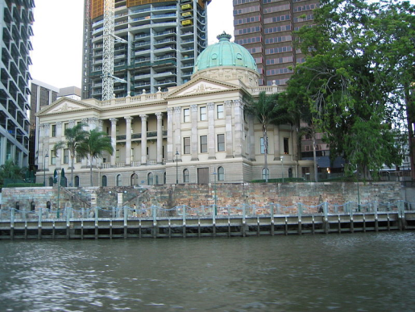
Trade
Different trade rules made doing business difficult and caused rivalry and suspicion between colonies.
Queensland one shilling revenue stamp
Tariffs (taxes) for bringing goods into Queensland were paid here at Customs House in Brisbane.
Notes:
Tariffs were applied to goods that crossed the borders between colonies. (Click) A tariff was a tax or duty that had to be paid on an item when it left one colony and went into another. Customs was the official government department that collected the tariffs. (Click) This picture is of Customs House in Brisbane, where ships arriving had to pay tariffs on the goods they were carrying.
Tariffs were applied to goods to make those coming from outside the colony more expensive. This protected the businesses inside the colony. (Click) Not all colonies charged tariffs. Some colonies had free trade and these different trade rules led to rivalry and suspicion between colonies.

Slide 7
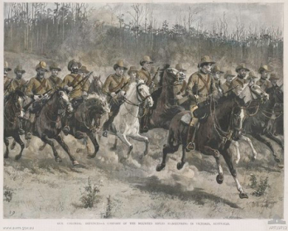
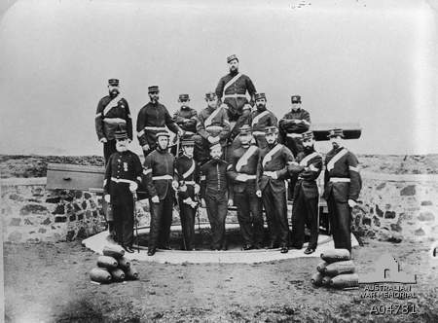
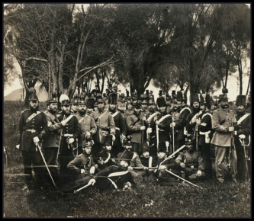
Defence
Victorian Mounted Rifles, 1889
Hobart Town Volunteer Artillery, 1869
With no national defence force, the colonies were worried about attack or invasion by other countries.
South Australian Volunteer Forces, 1860
Notes:
In 1868, convict transportation from England to Australia ended, and this was when Britain removed its military forces from the colonies. Each colony then became responsible for its own defence force. (Click) There wasn’t enough money for every colony to have a well-supplied army, so there were (Click) differences in training, experience, uniforms and duties between the colonies.
(Click) Many colonies were worried about being attacked or invaded by another country, as there was no navy responsible for protecting Australia’s coastline.

Slide 8
Problems of colonial life
Government
Employment of migrants
Power
Transport
Trade
Defence
Notes:
There were many problems of colonial life that prevented Australia’s progress. It was these issues that led people to start thinking about ways to (Click) solve problems or remove these colonial barriers.

Slide 9
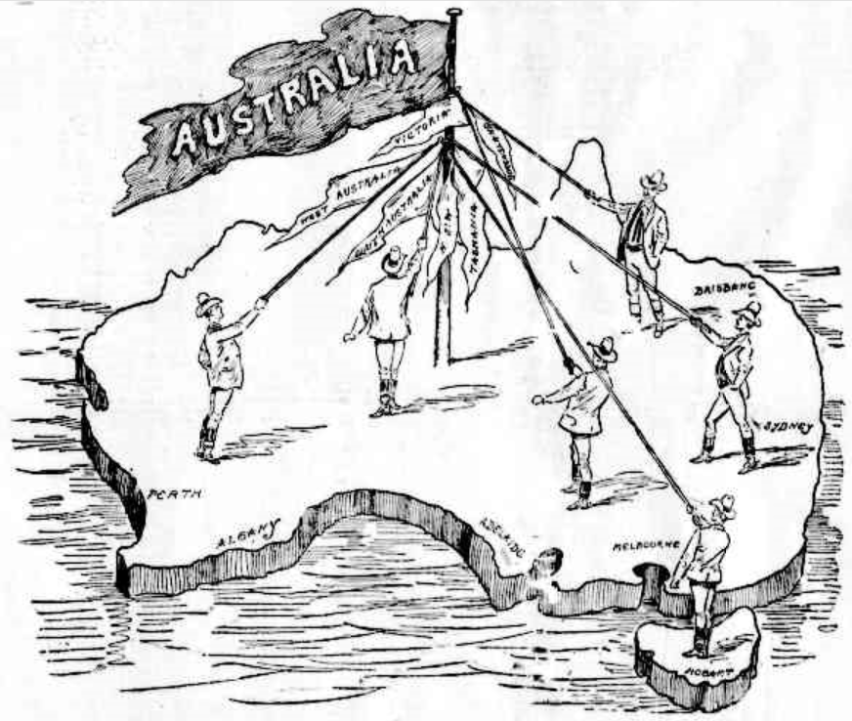
Federation seen as the solution to colonial problems
Political cartoon from ‘The Argus’ newspaper in Melbourne, 1898
Notes:
(Click) This was the beginning of a long debate that eventually led to Australia’s Federation.

Slide 10
Attributions
Slide 1: ‘The great work for Friday’ in The Argus (Melbourne), 1 June 1898, p.5, http://trove.nla.gov.au/ndp/del/page/310001
Slide 3: Crown, http://www.clker.com/clipart-15746.html
Muller, J. E. 1890-1900, Photographic portrait of a Chinese immigrant family in Suriname, (Tropenmuseum, part of the National Museum of World Cultures), http://commons.wikimedia.org/wiki/File:Tropenmuseum_Royal_Tropical_Institute_Objectnumber_60012337_Portret_van_een_Chinese_immigrantenfa.jpg CC BY-SA creativecommons.org/licenses/by-sa/3.0/
Kanaka labourers on a Queensland pineapple plantation, National Library of Australia, Image: nla.pic-an24494586 http://nla.gov.au/nla.pic-an24494586
Slide 4: Bernhard Otto Holterman with 630lb of gold, (State Library of NSW) http://commons.wikimedia.org/wiki/File:Bernhard_otto_holterman_with_630lb_gold_from_Hill_End.jpg
Sheep washing on Yandilla Station, Darling Downs, 1884, State Library of Queensland, John Oxley Library http://hdl.handle.net/10462/deriv/194021
Slide 5: Family in a horse drawn buggy in Bundaberg, ca. 1912 State Library of Queensland, John Oxley Library http://hdl.handle.net/10462/deriv/70184
Railway turntable http://commons.wikimedia.org/wiki/File:CRW_1138.jpg
Suitcase http://www.clker.com/clipart-29065.html
Slide 6: Queensland one shilling revenue stamp http://commons.wikimedia.org/wiki/File:Queensland_one_shilling_revenue_stamp.jpg?uselang=fr
Celcom, 2008, Customs House in Brisbane, Queensland. http://commons.wikimedia.org/wiki/File:Customs_House_Brisbane.jpg CC BY-SA 3.0 http://creativecommons.org/licenses/by-sa/3.0
Slide 7: Dadd, F., Our colonial defences: a company of the mounted rifles manoeuvring in Victoria, AWM ID: ART19712 (Australian War Museum) https://www.awm.gov.au/collection/ART19712/
Members of the Hobart Town Volunteer Artillery 1869, AWM ID: A04781 (Australian War Museum) https://www.awm.gov.au/collection https://www.awm.gov.au/collection/A04781/
South Australian Volunteer Forces in 1860, SLSA B5592 (State Library of South Australia), www.flickr.com/photos/32600408@N06/3254978126 CC BY 2.0 creativecommons.org/licenses/by/2.0/
Slide 9: ‘The great work for Friday’ in The Argus (Melbourne), 1 June 1898, p.5, http://trove.nla.gov.au/ndp/del/page/310001
All other images © DET

